Slide 1


Felipe
<Date>

Slide 2

Outline
Executive Summary
Introduction
Methodology
Results
Conclusion
Appendix

Slide 3
Executive Summary
Summary of methodologies
Data Collection via API and Web Scraping
Data Visualization for EDA
SQL for EDA
Interactive Map with folium library
Dashboard with Plotly Dash library
Predictive Analysis via ML techniques
Summary of all results
Exploratory Data Analysis Rresults
Interactive Map and Dashboard Results
Predictive Analysis Results

Slide 4
Introduction
Project background and context
The question is: Will the Falcon 9 first stage land successfully? This is a pivotal issue since the cost of a launch depends largely on it. SpaceX is able to offer a better price and save much money by reusing the first stage of its rockets. In fact, SpaceX advertises Falcon 9 rocket launches on its website with a cost of 62 million dollars, whereas other providers cost upward of 165 million dollars each. This information can be used if an alternate company wants to bid against SpaceX for a rocket launch.
Problems you want to find answers
How is a (un)succesful landing defined?
How do other variables influence the outcome of a landing?
How can we optimize the landing success rate?

Slide 5

Section 1

Slide 6
Methodology
Executive Summary
Data collection methodology:
SpaceX REST API
Web Scrapping from Wikipedia
Perform data wrangling
Selecting only necessary variables or features
One Hot Encoding of categorical variables
Perform exploratory data analysis (EDA) using visualization and SQL

Slide 7
Methodology
Executive Summary
Perform interactive visual analytics using Folium and Plotly Dash
Use maps and dashboard to get insights quick insights
Perform predictive analysis using classification models
Fine tune machine learning models with training data, then try them with test data to assess their predictive power

Slide 8
Data Collection
Datasets are collected from Rest SpaceX API and webscrapping Wikipedia
The Space X REST API URL is api.spacexdata.com/v4
The Wikipedia URL is: https://en.wikipedia.org/w/index.php?title=List_of_Falcon_9_and_Falcon_Heavy_launches&oldid=1027686922
SpaceX
Rest API
call
API returns
JSON file
Make dataframe from Json
Clean & Export the data
Get HTML response from Wikipedia
Extract data with Beautiful Soup
Make dataframe from Json
Clean & Export the data

Slide 9
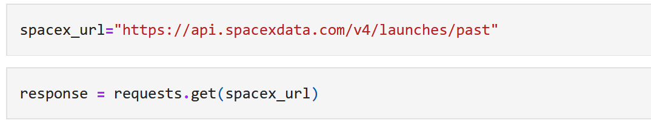
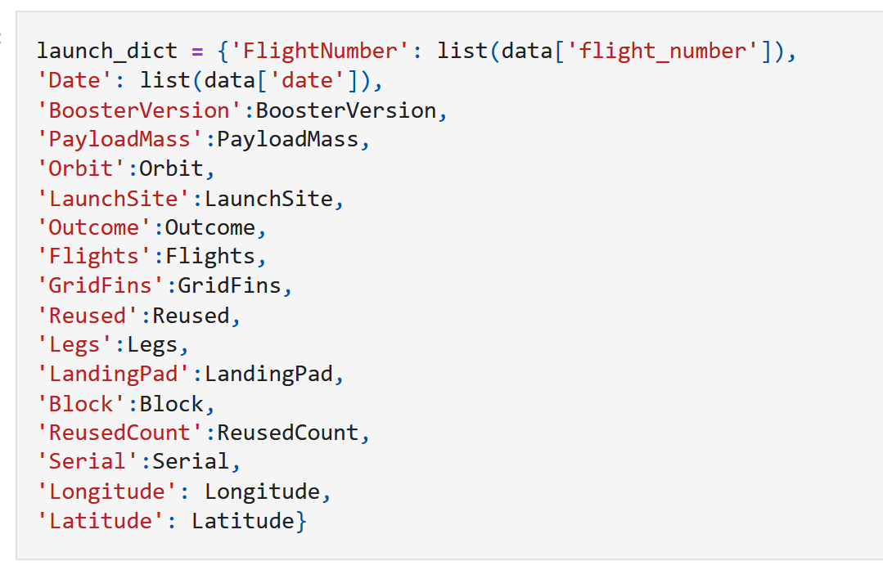
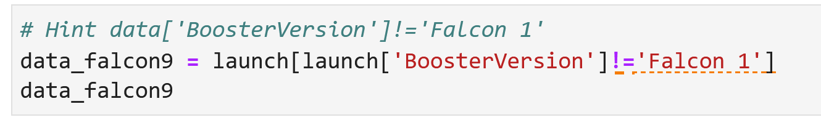
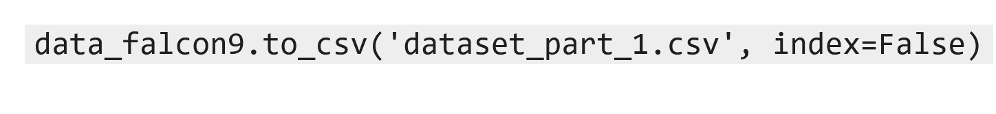
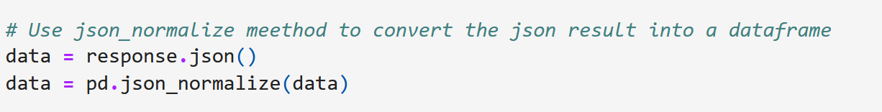
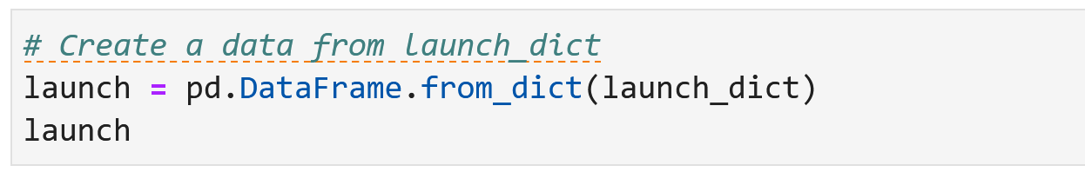
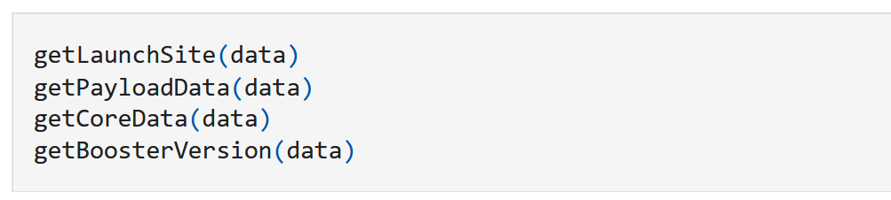
Data Collection – SpaceX API
1. Get Response from API
4. Create dictionary with data
6. Filter dataframe
7. Export as csv
2. Convert response to JSON FILE
5. Create dataframe
3. Transform data
Link to Github Notebook

Slide 10
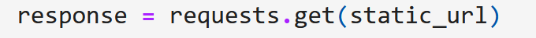
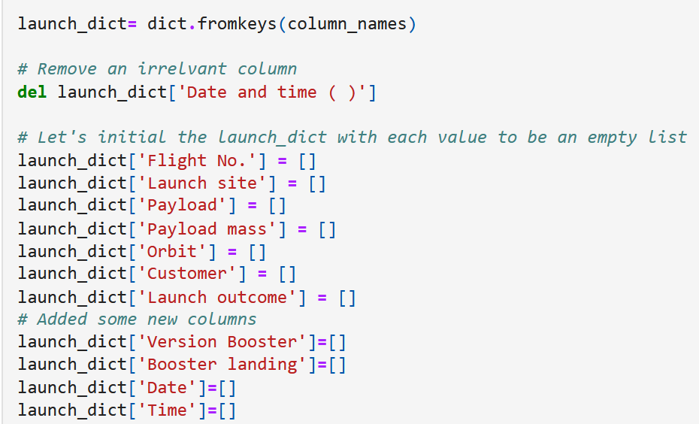
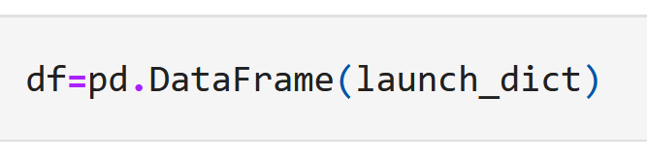
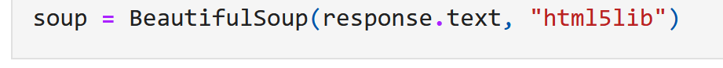
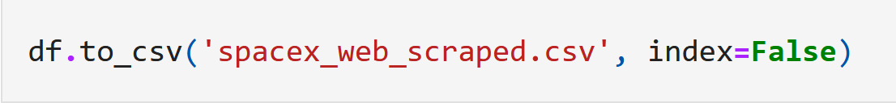
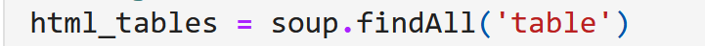
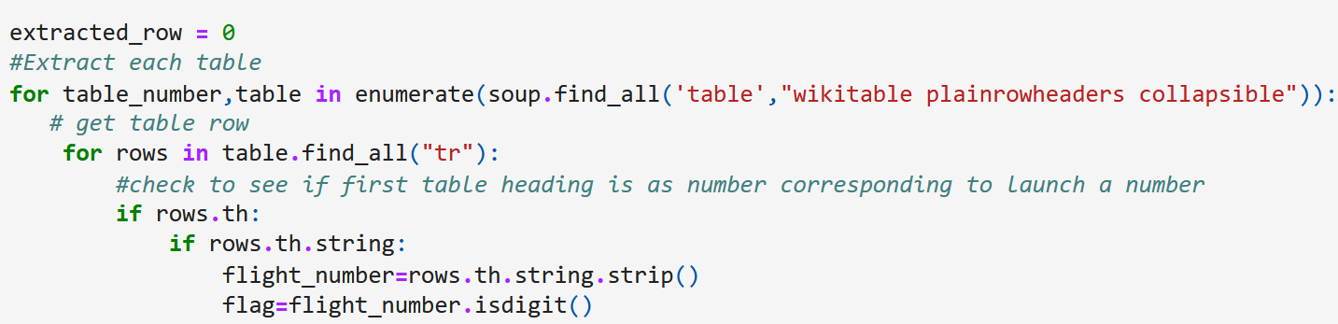
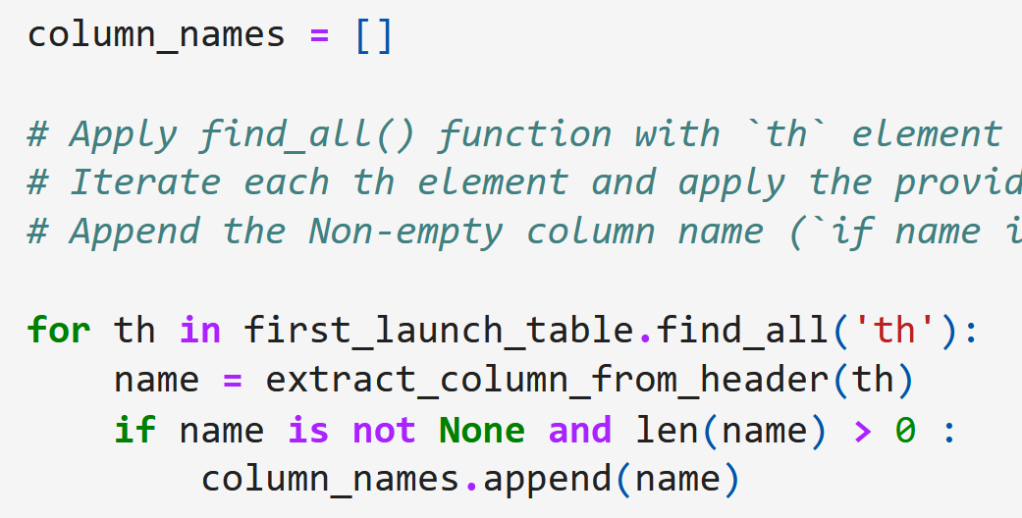
Data Collection – Scraping
1. Get Response from HTML
5. Create dictionary
7. Create dataframe from dictionary
2. Create BeautifulSoup object
7. Export to file
3. Find all tables
6. Add data to keys
4. Get columns names
Link to Github Notebook

Slide 11
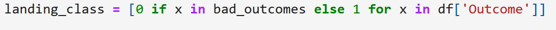
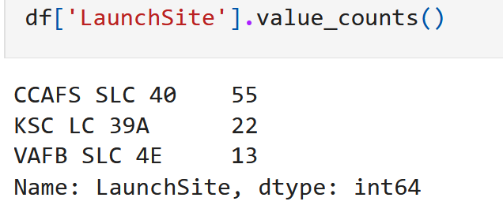
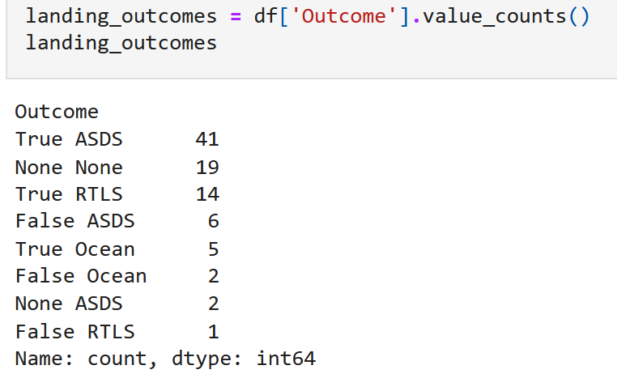
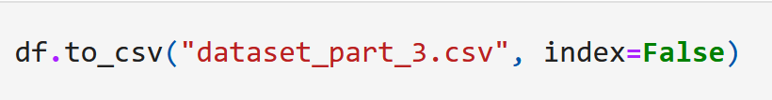
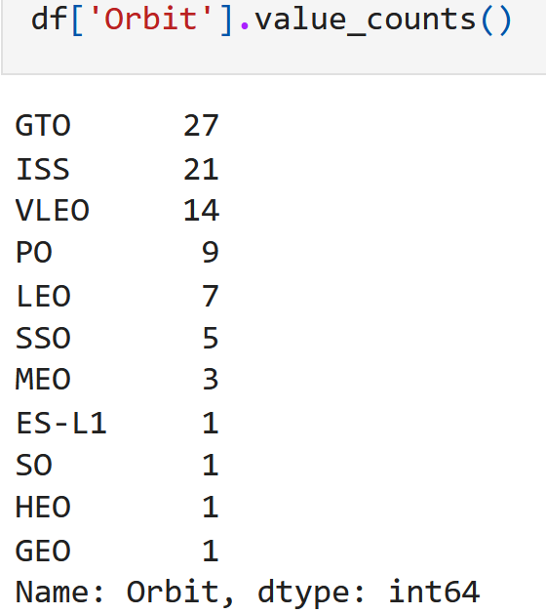
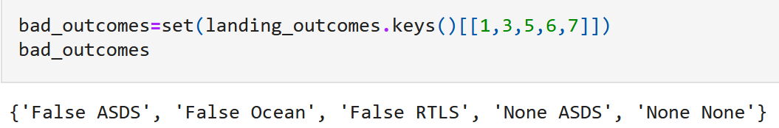
Data Wrangling
There are lots of instances where the landing outcome is not succesful
• Succesful attempts: True Ocean, True RTLS, True ASDS means the mission has been successful.
• Unsuccesful attempts: False Ocean, False RTLS, False ASDS means the mission was a failure.
Let us now transform string variables into categorical ones
1. Calculate number of launches for each site
3. Calculate number and occurrence of
mission outcome per orbit type
4. Create landing outcome label from Outcome column
2. Calculate the number and occurrence of each orbit
5. Export to file
Link to Github Notebook

Slide 12
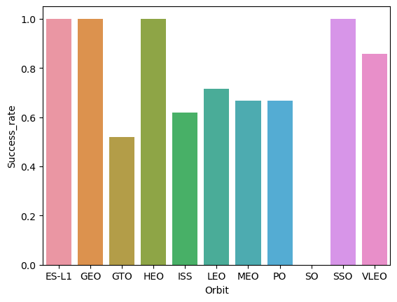
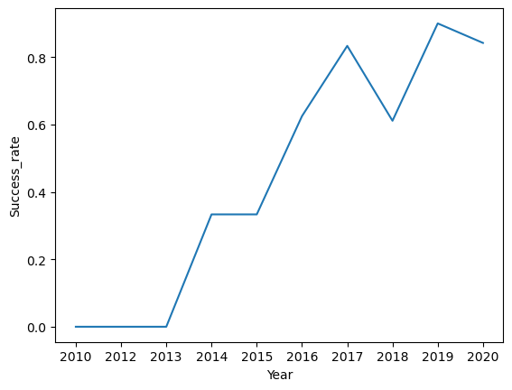
EDA with Data Visualization
Scatter Graphs [ X vs Y]
• Flight Number vs. Payload Mass
• Flight Number vs. Launch Site
• Payload vs. Launch Site
• Orbit vs. Flight Number
• Payload vs. Orbit Type
• Orbit vs. Payload Mass
Bar Graph [X vs Y]
• Orbit vs. Success rate
Line Graph [X vs Y]
• Year vs. Success rate
Link to Github Notebook

Slide 13
EDA with SQL
We performed 10 SQL queries to gather some basic insights. The complete list is as follows:
Display the names of the unique launch sites in the space mission
Display 5 records where launch sites begin with the string 'CCA'
Display the total payload mass carried by boosters launched by NASA (CRS)
Display average payload mass carried by booster version F9 v1.1
List the date when the first succesful landing outcome in ground pad was acheived.
List the names of the boosters which have success in drone ship and have payload mass greater than 4000 but less than 6000
List the total number of successful and failure mission outcomes
List the names of the booster_versions which have carried the maximum payload mass. Use a subquery
List the records which will display the month names, failure landing_outcomes in drone ship ,booster versions, launch_site for the months in year 2015.
Rank the count of landing outcomes (such as Failure (drone ship) or Success (ground pad)) between the date 2010-06-04 and 2017-03-20, in descending order.
Link to Github Notebook

Slide 14
Build an Interactive Map with Folium
• The folium map object is a map centered on NASA Johnson Space Center at Houson, Texas
• Red circle at NASA Johnson Space Center's coordinate with label showing its name (folium.Circle, folium.map.Marker).
• Red circles at each launch site coordinates with label showing launch site name (folium.Circle, folium.map.Marker, folium.features.DivIcon).
• The grouping of points in a cluster to display multiple and different information for the same coordinates (folium.plugins.MarkerCluster).
• Markers to show successful and unsuccessful landings. Green for successful landing and Red for unsuccessful landing. (folium.map.Marker, folium.Icon).
• Markers to show distance between launch site to key locations (railway, highway, coastway, city) and plot a line between them . (folium.map.Marker, folium.PolyLine, folium.features.DivIcon)
• These objects are created in order to understand better the problem and the data. We can show easily all launch sites, their surroundings and the number of successful and unsuccessful landings
Link to Github Notebook

Slide 15
Build a Dashboard with Plotly Dash
• Dashboard has dropdown, pie chart, rangeslider and scatter plot components
• Dropdown allows a user to choose the launch site or all launch sites (dash_core_components.Dropdown).
• Pie chart shows the total success and the total failure for the launch site chosen with the dropdown component (plotly.express.pie).
• Rangeslider allows a user to select a payload mass in a fixed range (dash_core_components.RangeSlider).
• Scatter chart shows the relationship between two variables, in particular Success vs Payload Mass (plotly.express.scatter)
Link to Github Notebook

Slide 16
Predictive Analysis (Classification)
• Data preparation
Load dataset
Normalize data
Split data into training and test sets.
• Model preparation
Selection of machine learning algorithms
List of hyperparameters to try
Get hyperparameters for each algorithm with GridSearchCV
Training GridSearchModel models with training dataset to obtain parameters
• Model evaluation
Compute accuracy for each model with test dataset
Plot Confusion Matrix
• Model comparison
Comparison of models according to their accuracy
The model with the best accuracy will be chosen
Link to Github Notebook

Slide 17
Results
Exploratory data analysis results
Interactive analytics demo in screenshots
Predictive analysis results

Slide 18

Section 2

Slide 19
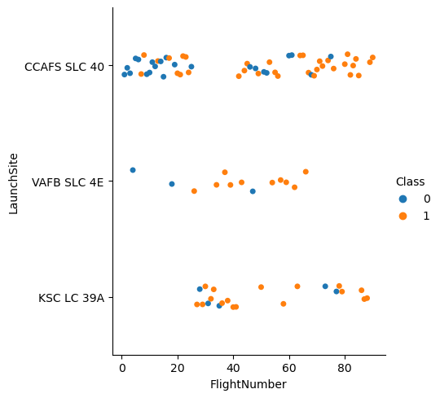
Flight Number vs. Launch Site
Observations
As the flight number increases the success rate tends to increase this is particularly for launch site ccafs slc 40
Around flight number 70 the success rate noticeably high

Slide 20
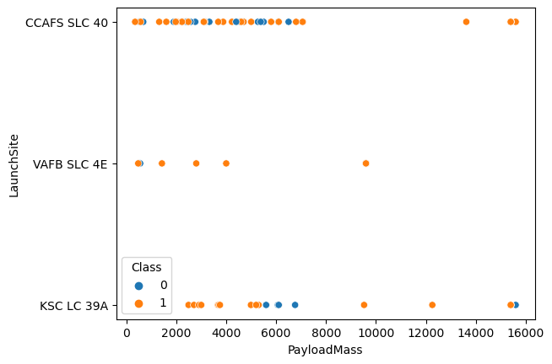
Payload vs. Launch Site
Observations
Launch site ccafs slc 40 seems heavily dependent on a high Payload mass to get a high success rate, of around 7000 kg.
That is not the case for the other launch sites whose success rates are good, both with low and high payload mass.

Slide 21
Success Rate vs. Orbit Type
Observations
It is obvious from the chart that the orbits with the highest success rate are ES-L1, GEO, HEO, SSO, with a perfect score.

Slide 22
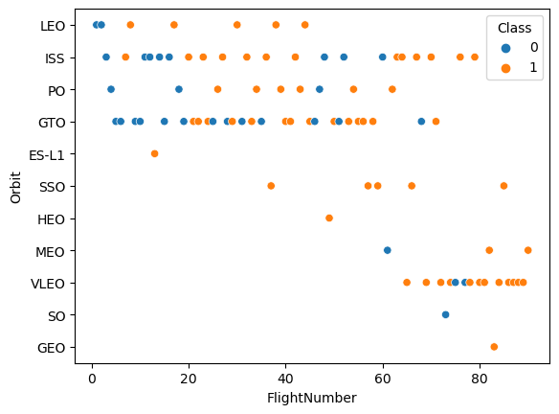
Flight Number vs. Orbit Type
Observations
As previously observed in another chart, the success rate increases as the number of flights increases.
That’s very obvious for the LEO orbit, to some extent for PO and ISS orbits, whereas it’s pretty much absent for GTO orbit.
The launches to the other orbits seem to have benefited from previous experience.

Slide 23
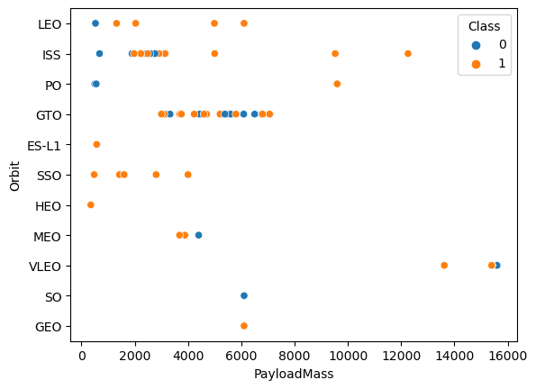
Payload vs. Orbit Type
Observations
The LEO orbit improves its success rate as the payload increases
The same applies to some extent to ISS orbit
The GTO orbit success rate is equally mixed everywhere.

Slide 24
Launch Success Yearly Trend
Observations
The trend since 2013 is markedly positive, reaching a first peak of over 80% in 2017 and a second of over 90% in 2019.
There was a setback in 2018 when the success rate fell to under 60%

Slide 25
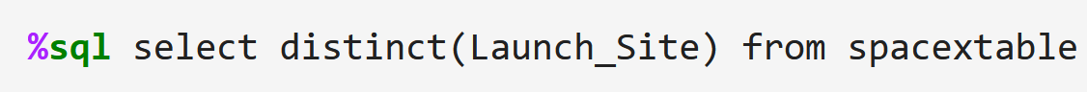
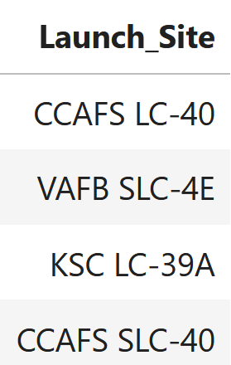
All Launch Site Names
QUERY
Unique Launch Sites
Explanation
Using the SQL language we ask the computer to give us every launch site in the “Launch_Site” column without repeating their names.

Slide 26
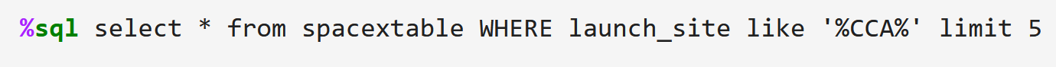
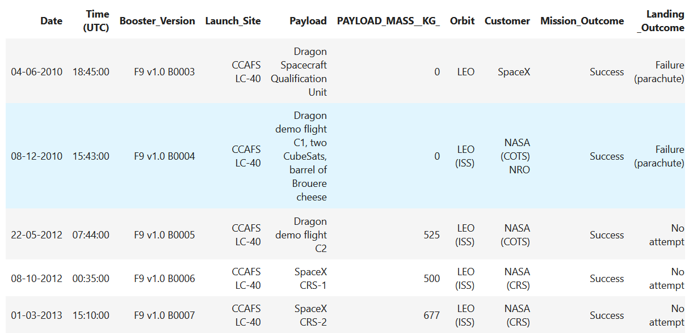
Launch Site Names Begin with 'CCA'
QUERY
Launch Sites beginning with ‘CCA’
Explanation
Using the SQL language we ask the computer to give us the first five rows where the “Launch_Site” column starts with ‘CCA’.

Slide 27
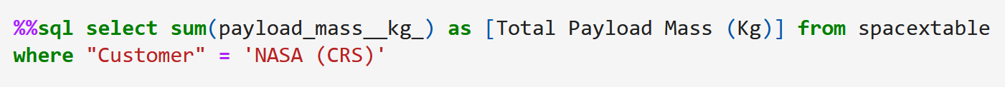
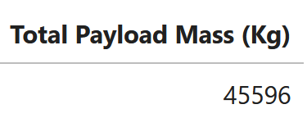
Total Payload Mass
QUERY
Total Payload Mass
Explanation
Using the SQL language we ask the computer to give us the total payload mass in Kg carried by boosters launched by NASA (CRS).

Slide 28
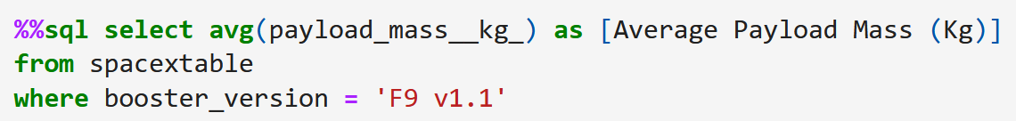
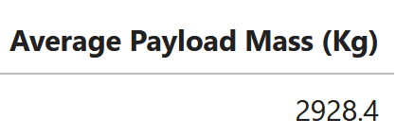
Average Payload Mass by F9 v1.1
QUERY
Average Payload Mass by F9 v1.1
Explanation
Using the SQL language we ask the computer to give us the average payload mass in Kg carried by F9 v1.1 boosters.

Slide 29
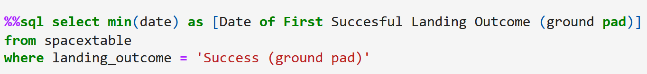
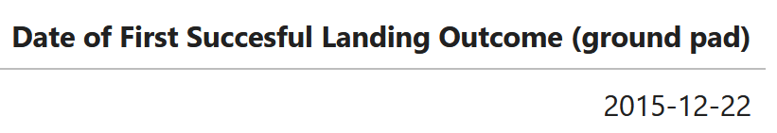
First Successful Ground Landing Date
QUERY
Date
Explanation
Using the SQL language we ask the computer to give us the date when the outcome of a landing on a ground pad was successful for the first time.

Slide 30
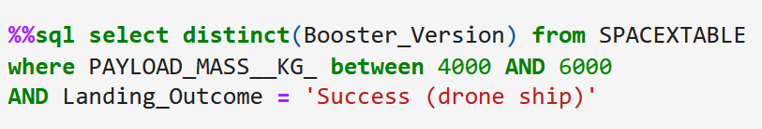
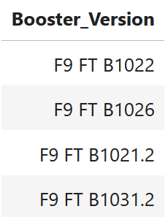
Successful Drone Ship Landing with Payload between 4000 and 6000
QUERY
List of Booster Versions
Explanation
Using the SQL language we ask the computer to give us the of Booster Versions which have landed successfully on drone ships with payload between 4000 and 6000 kg.

Slide 31
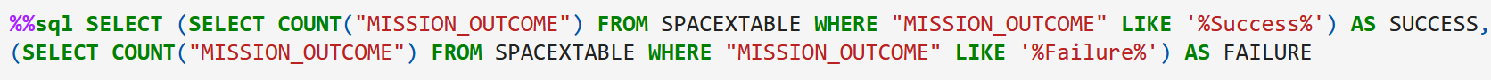
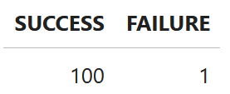
Total Number of Successful and Failure Mission Outcomes
QUERY
Success and Failure
Explanation
Using the SQL language we ask the computer to create two columns summarizing the outcomes of missions as success or failure.

Slide 32
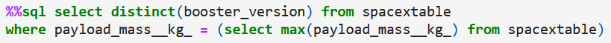
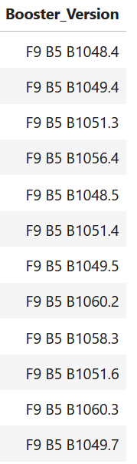
Boosters Carried Maximum Payload
QUERY
List of Booster Versions
Explanation
Using the SQL language we ask the computer to list the booster version having carried the maximum payload.

Slide 33
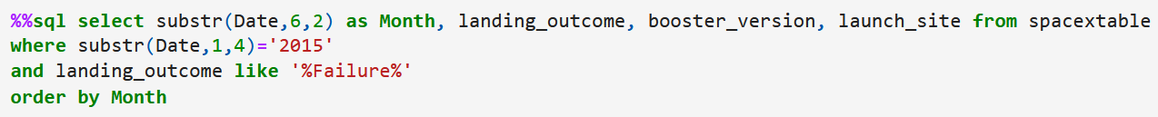
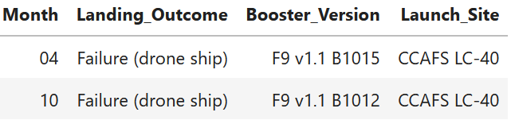
2015 Launch Records
QUERY
List of Booster Versions
Explanation
Using the SQL language we ask the computer to show us the month, landing outcome, booster version and launch site in 2015 when the landing outcome was a failure.

Slide 34
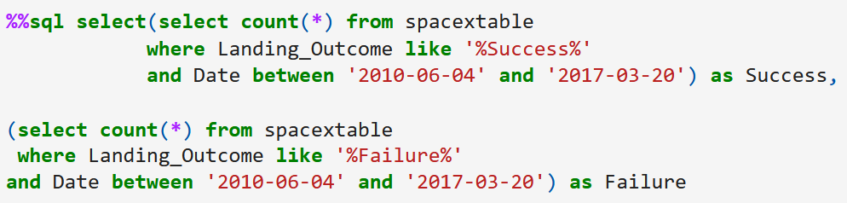
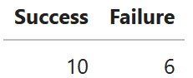
Rank Landing Outcomes Between 2010-06-04 and 2017-03-20
QUERY
List of Booster Versions
Explanation
Using the SQL language we ask the computer to create two columns summarizing the outcomes of landings as success or failure, for a time frame between 04/06/2010 and 20/03/2017

Slide 35

Section 3

Slide 36
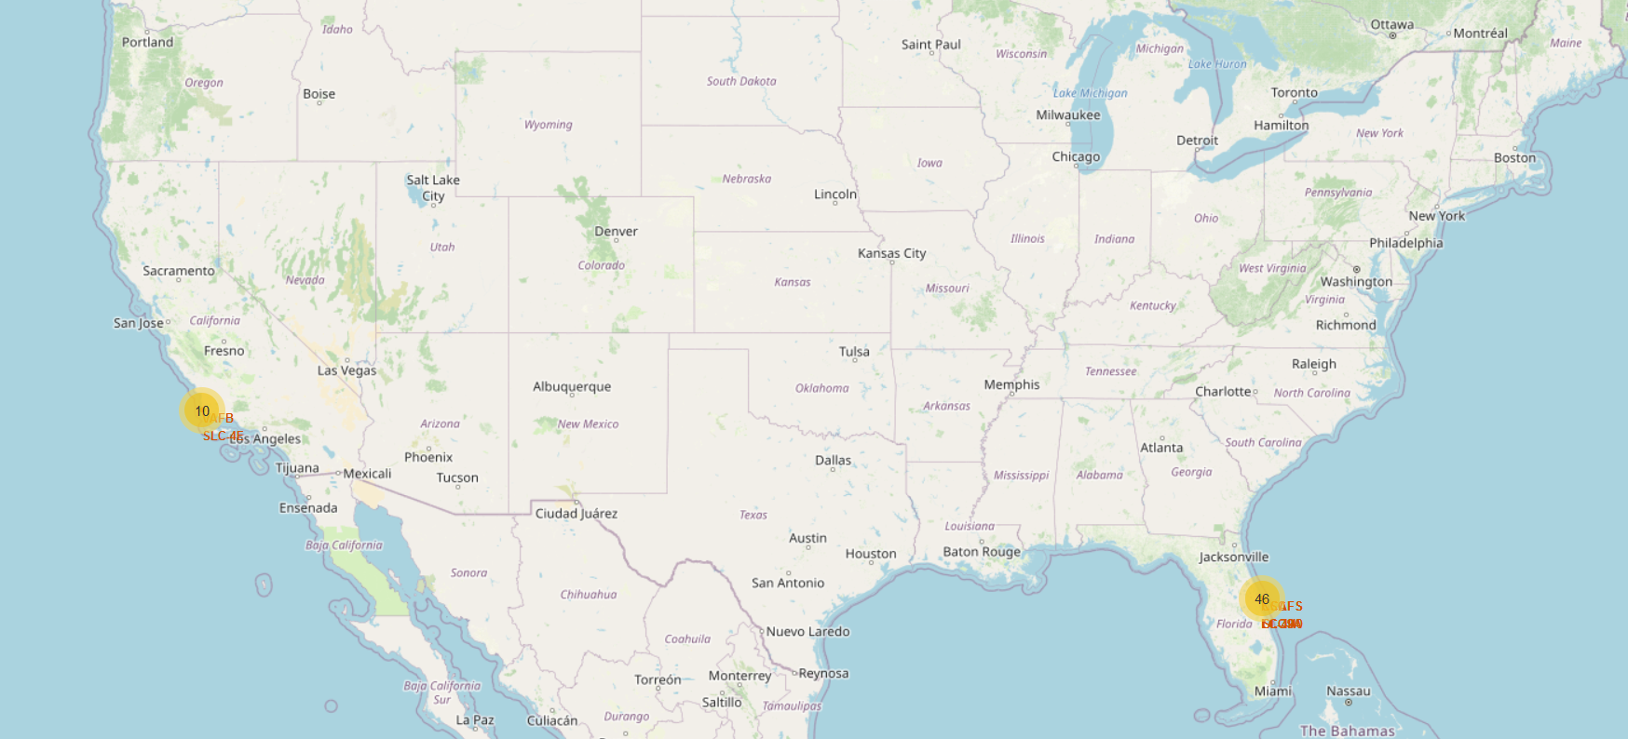
Map–Launch Sites
Spacex has launch sites on both coastlines but three of four are located on the east coast in Florida. The other is in South California.

Slide 37
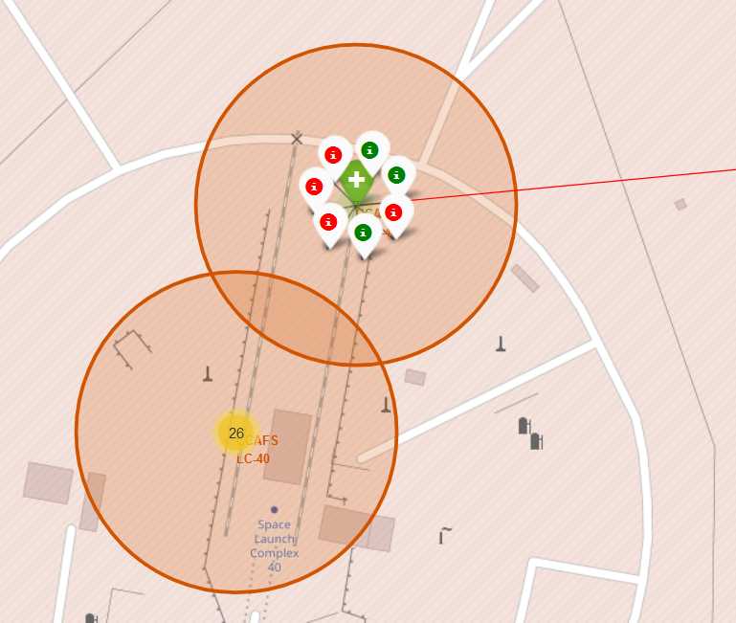
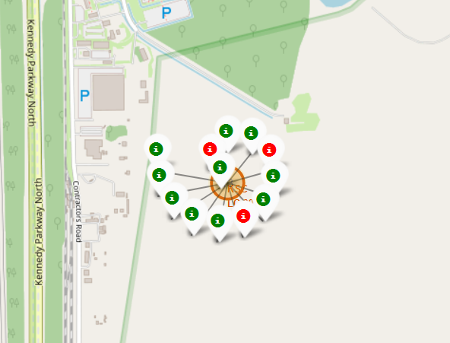


Map–Color-labeled launch outcomes
3
4
1
2
Green represents successful launches whereas red represents unsuccesful ones. 1) ccafs slc-40, 2) ccafs lc-40, 3) KSC LC 39-A, 4) VAFB SLC-4E. Clearly, KSC LC 39-A has the best success rate.

Slide 38

<Folium Map Screenshot 3>

Slide 39

Section 4

Slide 40

Total Success Launches for all Sites
According to the pie chart, the KSC LC-39A launch site has the highest participation in successful launches of all four, with a score 41.7%. This is followed in second place by CCAFS LC-40, with 29.2%.

Slide 41

Total success launches for Site KSC LC-39A
Now, 76.9% of the launches from the KSC LC-39A site have had success and 23.1% of them have failed.

Slide 42

Correlation between Payload and Success for all Sites
Up to a payload mass of about 6,000 kg there is no clear correlation between success and failure, but beyond that point failure becomes the norm.

Slide 43

Section 5

Slide 44

Classification Accuracy
All of the models have the same accuracy score on the test data. Things are a bit different with the train data, though.
The SVM model gets the best score using the train data, but not by much.

Slide 45

Confusion Matrix
Since the accuracy score on the test data is identical for every model, it is no surprise that the confusion matrix is likewise identical for all of them.
It turns out these models have no false negatives, but do have three false positives each. That’s their major problem, It is, however, far from fatal.
TN | FP
FN | TP

Slide 46
Conclusions
As more experience is gained the launch success rate tends to increase
Beyond payload mass of 6000 kg, failure is almost certain.
HEO, GEO, SSO, ES-L1 are the orbits with highest success rate.
Still some orbits seem to depend more on the payload mass than the rest, that is true for LEO in particular.
Some launch sites have a far better success rate than others, but we cannot make a confident guess based on the data available.
The Support vector Machine algorithm turned to be the best on the train data and as good as any other on the test data at predicting the launch outcome based on some previously chosen variables.

Slide 47
Appendix
Include any relevant assets like Python code snippets, SQL queries, charts, Notebook outputs, or data sets that you may have created during this project

Slide 48


